Slide 1

Pandas

Slide 2
Pandas
We can use pandas to:
Read in data from csv/excel and a lot of other formats.
Manipulate data.
Visualize data (we can also use other tailored libs for that).
Filter and aggregate data

Slide 3
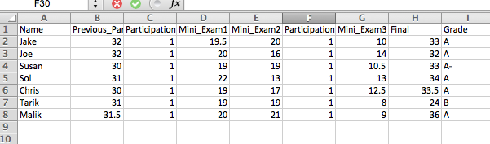
Reading in Data From CSV
Suppose you have the following data saved in the file “Grades_Short.csv”:
Let’s see how we read this data into pandas:

Slide 4
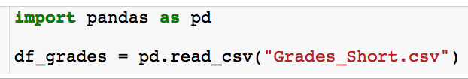
Reading in Data From CSV
Before you use pandas you must import it. Anytime you use pandas put this line as the top of your code.
Let’s see how we read this data into pandas:

Slide 5
Reading in Data From CSV
Reading the data into a variable called df_grades.
Let’s see how we read this data into pandas:
Built in read_csv method
Path to file

Slide 6
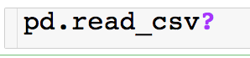
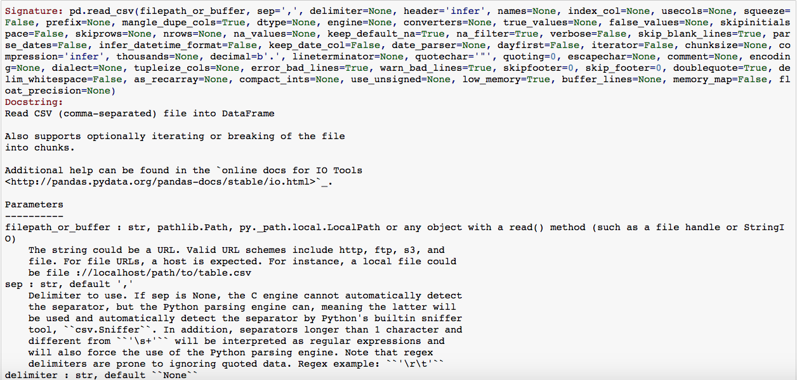
Pandas – read_csv

Slide 7
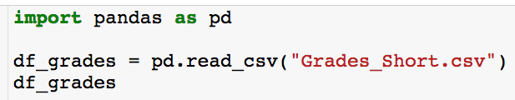
Reading in Data From CSV
So, what is df_grades and how does it store the data?
Typing the name of any variable at the end of a code cell will display the contents of the variable.

Slide 8
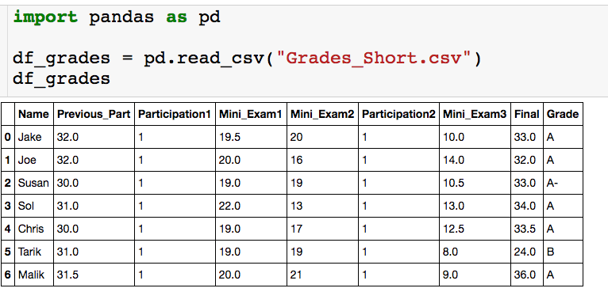
Reading in Data From CSV
So, what is df_grades and how does it store the data?
df_grades is a pandas dataframe.
The data is stored in a tabular format very similar to excel.

Slide 9
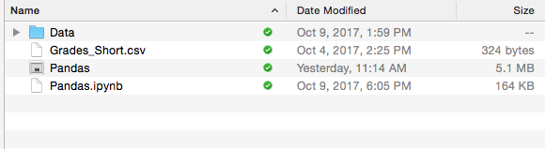
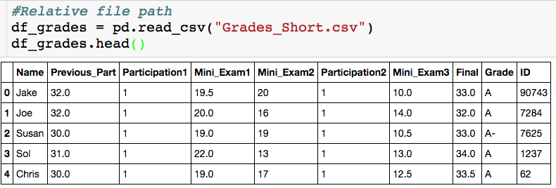
Reading in Data From CSV
Data file
Jupyter notebook

Slide 10
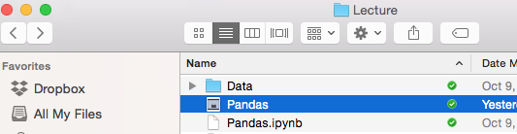
Reading in Data From CSV
Now Grades_Short.csv is in Data Folder
Jupyter notebook

Slide 11
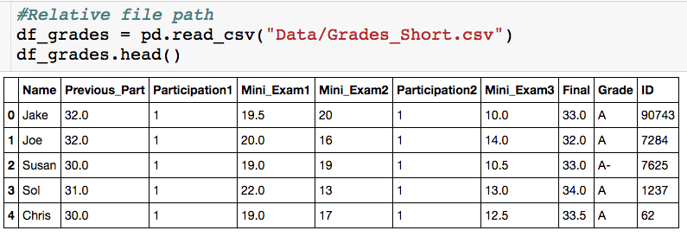
Reading in Data From CSV
Now Grades_Short.csv is in Data Folder
Jupyter Notebook
“/” separates directories

Slide 12
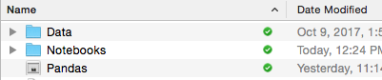
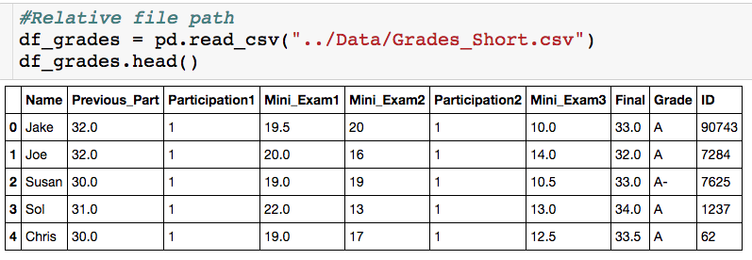
Reading in Data From CSV
Now Grades_Short.csv is in Data Folder
Jupyter notebook in folder Notebooks
“..” = go back one directory

Slide 13
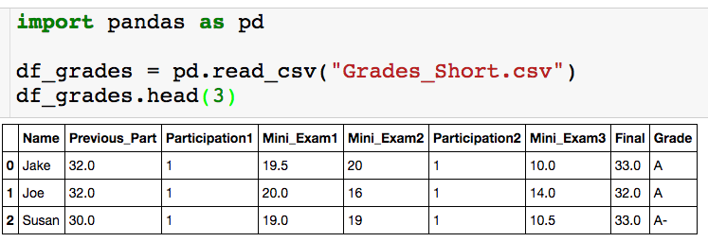
The head() Method
Using the head() method
If the data is really large you don’t want to print out the entire dataframe to your output.
The head(n) method outputs the first n rows of the data frame. If n is not supplied, the default is the first 5 rows.
There is also a tail(n) method that returns the last n rows of the dataframe

Slide 14
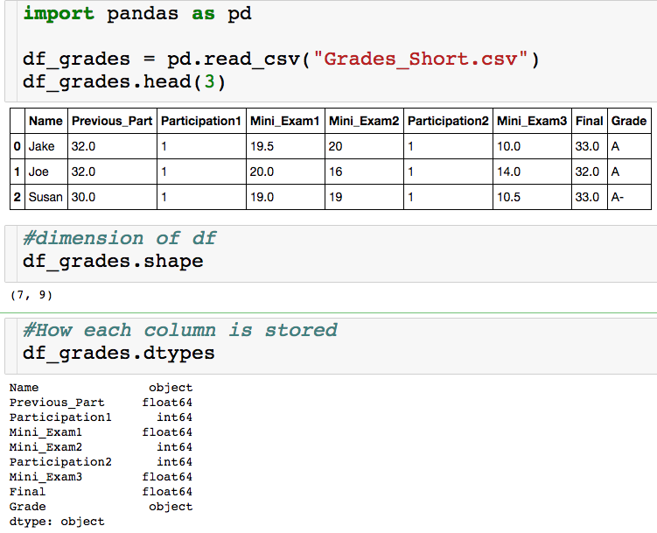
Basic Features
Think of this as a list
object = string
float64 = decimal
int64 = integer

Slide 15
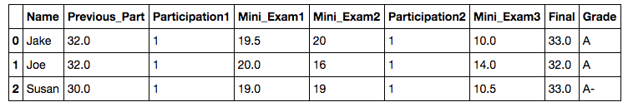
Basic Features
column names
row names = index

Slide 16
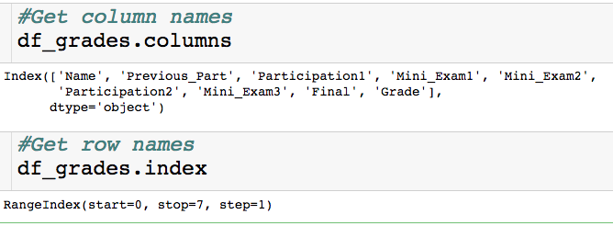
Basic Features
column names
row names = index

Slide 17
Basic Features
column names
row names = index
Pandas defaults to have the index be the row number and it will automatically recognize that the first row is the column names.
Next we discuss how to pick out various pieces of the dataframe.

Slide 18
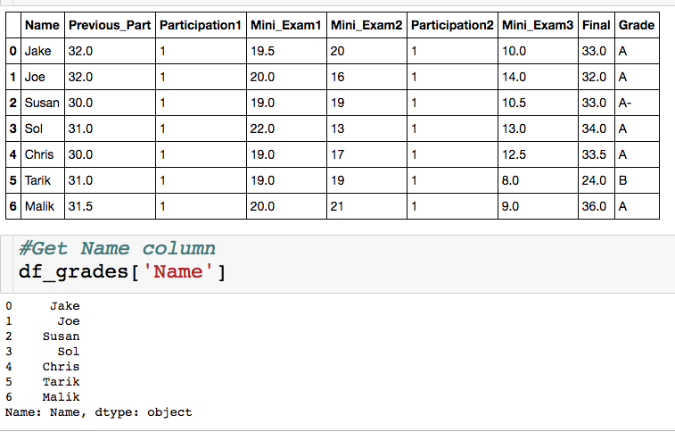
Selecting a Single Column
Between square brackets, the column must be given as a string
Outputs column as a series
A series is a one dimensional dataframe..more on this in the slicing section

Slide 19
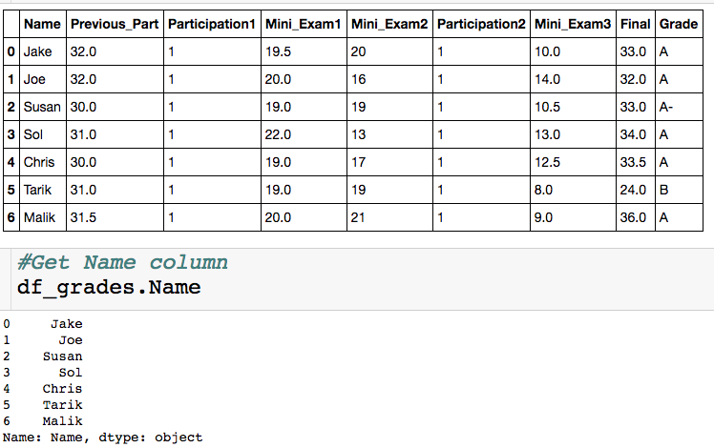
Selecting a Single Column
Exactly equivalent way to get Name column
+ : don’t have to type brackets or quotes
-: won’t generalize to selecting multiple columns, won’t work if column names have spaces, can’t create new columns this way

Slide 20
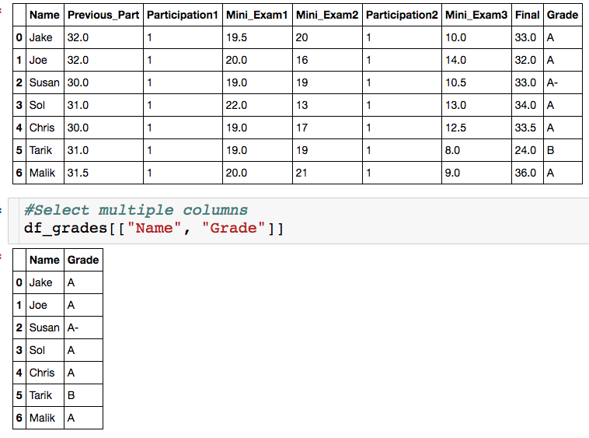
Selecting Multiple Columns
List of strings, which correspond to column names.
You can select as many column as you want.

Slide 21
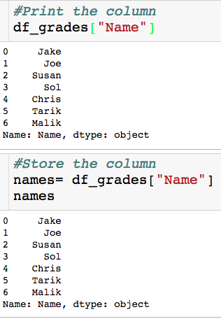
Storing Result
Why store a slice?
We might want/have to do our analysis in steps.
Less error prone
More readable
The variable name stores a series

Slide 22
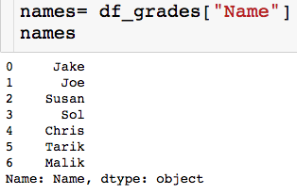
Slicing a Series
Slice/index through the index, which is usually numbers

Slide 23
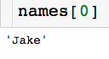
Slicing a Series
Slice/index through the index, which is usually numbers
Picking out single element

Slide 24
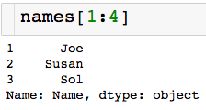
Slicing a Series
Slice/index through the index, which is usually numbers
Picking out single element
Contiguous slice
non_inclusive

Slide 25
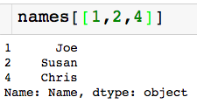
Slicing a Series
Slice/index through the index, which is usually numbers
Picking out single element
Contiguous slice
Arbitrary slice

Slide 26
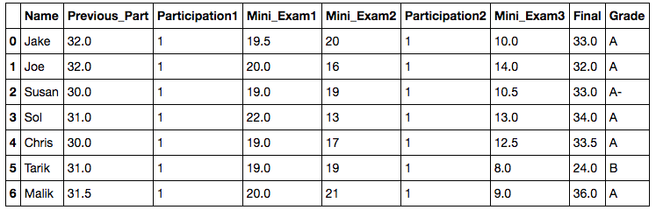
Slicing a Data Frame
There are a few ways to pick slice of a data frame, we will use the .loc method.
Access elements through the index labels and column names
We will see how to change both of these labels later on

Slide 27
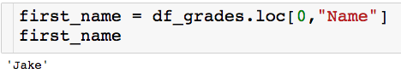
Slicing a Data Frame
Pick a single value out.
Column name (string)
Index label (number)

Slide 28
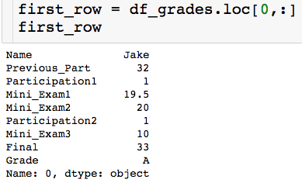
Slicing a Data Frame
Pick out entire row:
“pick out all columns”
first_row is a series

Slide 29
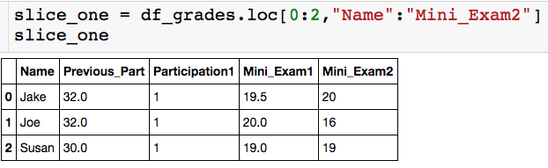
Slicing a Data Frame
Pick out contiguous chunk:
Endpoints are inclusive!

Slide 30
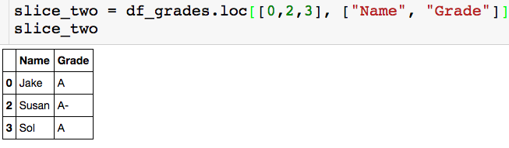
Slicing a Data Frame
Pick out arbitrary chunk:

Slide 31
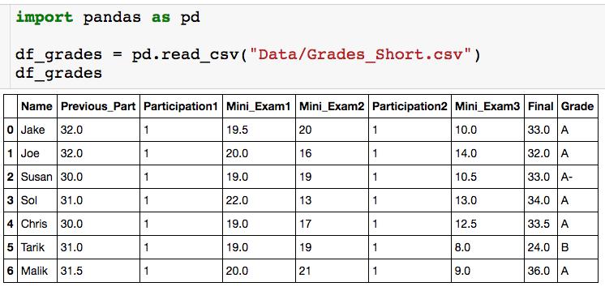
Built in Functions
How do I compute the average score on the final?

Slide 32
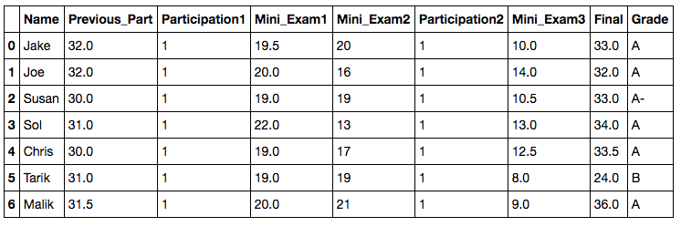
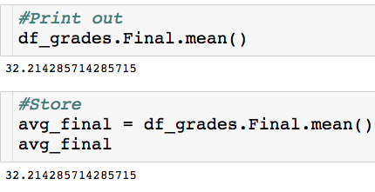
Built in Functions
How do I compute the average score on the final?
Built in mean() method

Slide 33
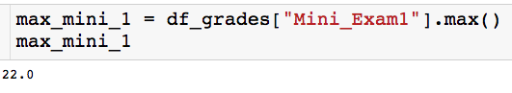
Built in Functions
How do I compute the highest Mini Exam 1 score?

Slide 34
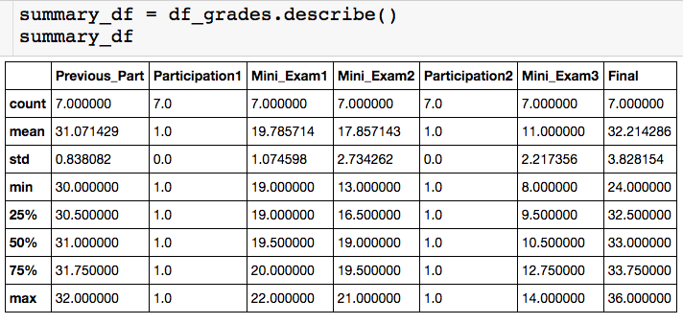
Built in Functions
I can actually get all key stats for numeric columns at once with the describe() method:
summary_df is a dataframe!

Slide 35
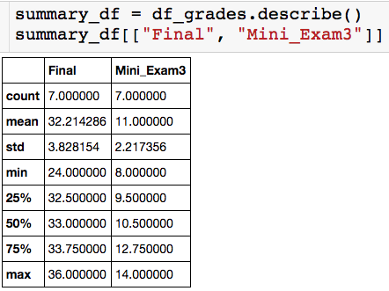
Built in Functions
I can actually get all key stats for numeric columns at once with the describe() method:
Notes:
For df[[colname(s)]] , the interior brackets are for list, and the outside brackets are indexing operator, i.e. you must use double brackets if you select two or more columns. With one column name, single pair of brackets returns a Series, while double brackets return a dataframe

Slide 36
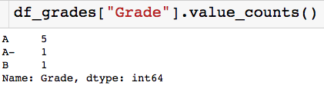
Built in Functions
Other useful built in methods:
value_count(): Gives a count of the number of times each unique value apears in the column. Returns a series where indices are the unique column values.

Slide 37
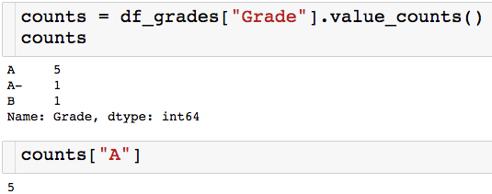
Built in Functions
Other useful built in methods:
value_count(): Gives a count of the number of times each unique value appears in the column. Returns a series where indices are the unique column values.

Slide 38
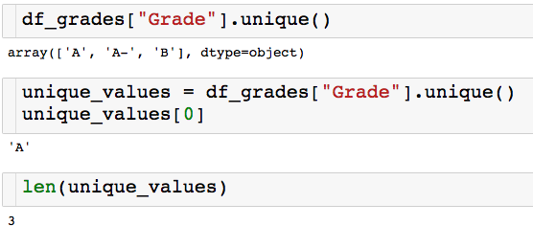
Built in Functions
Other useful built in methods:
unique(): Returns an array of all of the unique values.

Slide 39
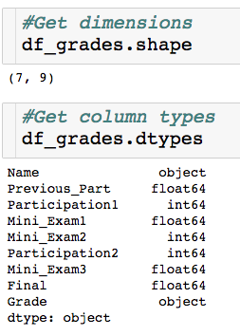
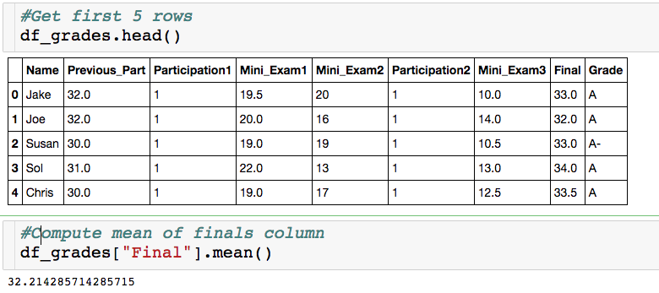
Attributes vs. Methods
When do I a put a ()?

Slide 40
Attributes vs. Methods
When do I a put a ()?
dataframe attributes
dataframe methods

Slide 41
Attributes vs. Methods
When do I a put a ()?
dataframe attributes
dataframe methods
Require computation for output
Features of dataframe

Slide 42
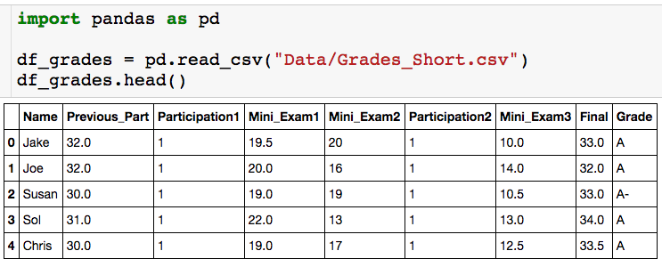
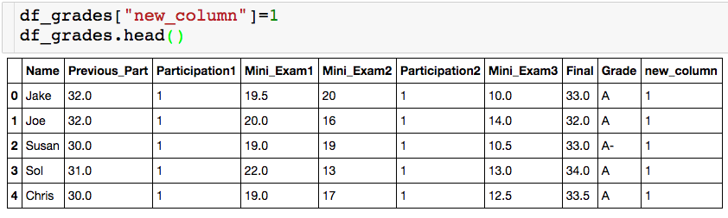
Creating New Columns
Let’s create a useless new column of all 1s:

Slide 43
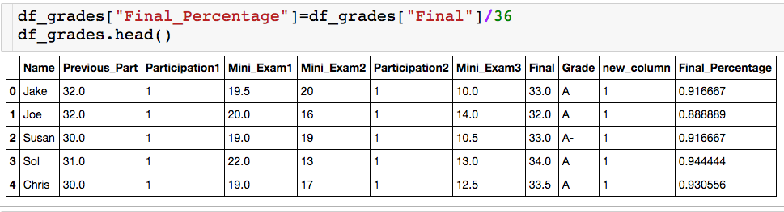
Creating New Columns
We can also create column as function of other column. The Final was worth 36 points, let’s create a column for each student’s percentage.

Slide 44
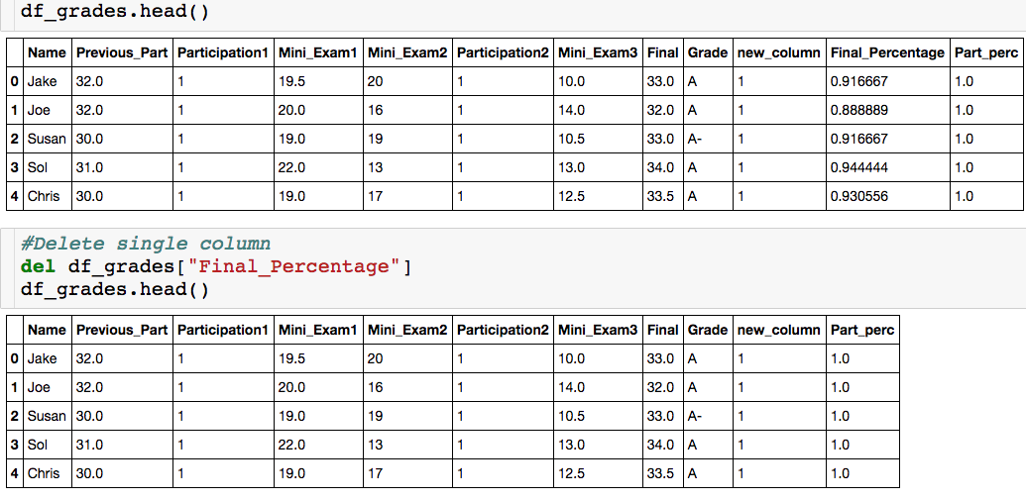
Deleting Columns

Slide 45
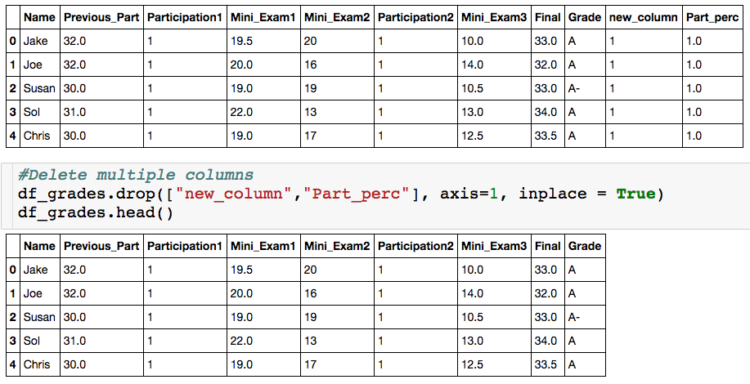
Deleting Columns

Slide 46
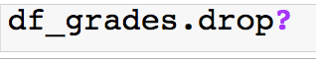
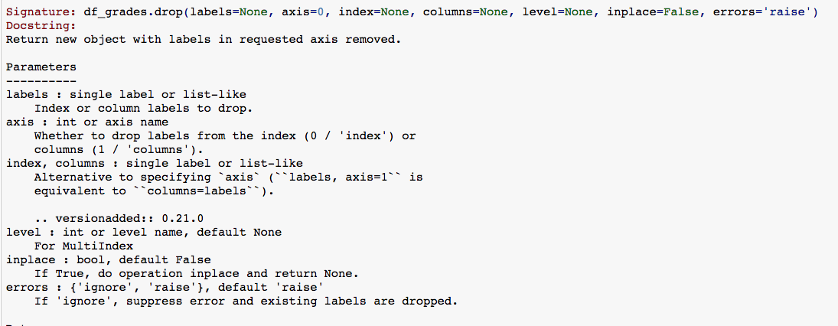
Deleting Columns

Slide 47
The Drop Method
List of column label

Slide 48
The Drop Method
List of column label
axis = 1 – delete specified columns
axis = 0 – delete specified rows

Slide 49
The Drop Method
inplace = True– change df_grades
inplace = False – return dataframe with specified columns deleted, do not change df_grades
List of column label
axis = 1 – delete specified columns
axis = 0 – delete specified rows

Slide 50
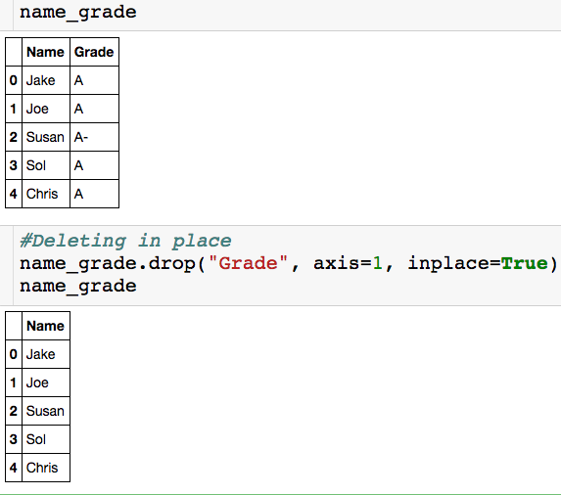
The Drop Method - inplace
The column “Grade” is removed from name_grade

Slide 51
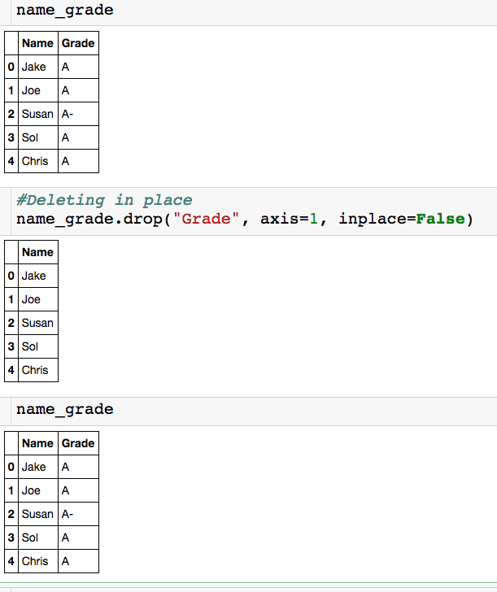
The Drop Method - inplace
Just returns a dataframe with “Grade” deleted.
The dataframe name_grade is unchanged.

Slide 52
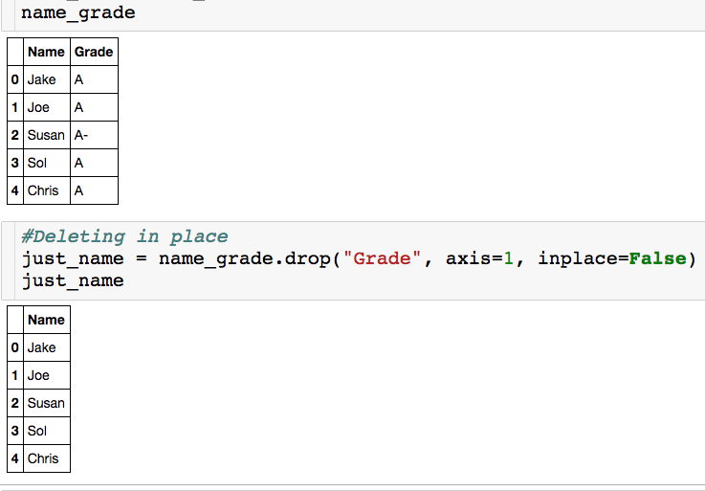
The Drop Method - inplace
Have to store the result in a variable to use the dataframe with “Grade” deleted.

Slide 53

The Drop Method - axis
List of row index to be deleted

Slide 54

Sorting Dataframes

Slide 55

Sorting Dataframes

Slide 56


Parking Ticket Data
Suppose we have the following data saved in the file “Parking.csv”:
Let’s see what happens when we read in the data
Unwanted column

Slide 57
Parking Ticket Data
Let’s see what happens when we read in the data
Unwanted column

Slide 58

Pandas – read_csv

Slide 59

Parking Ticket Data
Let’s see what happens when we read in the data
Specifies which column in the file should be the index col.

Slide 60

Parking Ticket Data
All columns are stored as strings!

Slide 61
Parking Ticket Data
All columns are stored as strings!
Two options to convert Issue_Date column to datetime:
Tell pandas Issue_Date is a datetime when reading in the data.
Convert the column after having read in the data.

Slide 62

Pandas – read_csv

Slide 63

Converting to Datetime
Option 1:
Now Issue_Date is stored as a datetime!

Slide 64
Converting to Datetime
Option 1:
List of column names that you want read in as datetimes.
Pandas usually just figures out format.
Now Issue_Date is stored as a datetime!

Slide 65

Converting to Datetime
Option 2:
Wrap column in to_datetime() built in function

Slide 66

Timestamp Attributes

Slide 67


Timestamp Attributes

Slide 68

Creating New Columns from Datetime Column
Need .dt if we are applying datetime attributes to a series.

Slide 69

Changing Column Names

Slide 70

Changing Column Names

Slide 71
Changing Column Names
“curly” brackets around new column name assignments

Slide 72
Changing Column Names
“old_column_name”: “new_column_name”

Slide 73
Changing Column Names
inplace = False (default) returns a new dataframe (df_grades is unaltered) with updated column names.

Slide 74

Concatenating DataFrames - Stacked
Let’s say you had separate csv files with the info for the students who got an A and everyone else, but you want to analyze everything together.

Slide 75
Concatenating DataFrames - Stacked
List of dataframes to concatenate

Slide 76
Concatenating DataFrames - Stacked
axis = 0 (default) – combine the two dataframes by stacking them on top of each other. Set axis =1 to stack side by side.

Slide 77

Concatenating DataFrames - Stacked
# of columns has to match
What is going to happen to index?

Slide 78

Concatenating DataFrames - Stacked
We got a repeated index, which is not good!
We will eventually see how to “reset” the index.
We can also correct this when we concatenate.

Slide 79

Concatenating DataFrames - Stacked

Slide 80

Using the Index
The index in this case is row numbers.
What if I want to quickly see Joe’s row?
I have to look up what row Joe is in.
Instead, I can make column as index.

Slide 81

Using the Index
Column that will become index (make sure this is unique).

Slide 82
Using the Index
Modify df_grades

Slide 83

Using the Index
The index is now the name column!

Slide 84

Using the Index

Slide 85

Using the Index
Want to make new ID column the index

Slide 86

Using the Index
This accomplishes the task but we lose the name column.

Slide 87

Using the Index

Slide 88

Resetting Index
How do I go back to having row numbers?

Slide 89


Using the Index
reset_index() will make your index row numbers again.
Useful when manipulating dataframes and index can get messed up

Slide 90


Missing Data
Not that different columns have different indicators for missing data.

Slide 91

Missing Data
We can replace the missing data with a true NaN (right now everything is just a string).

Slide 92

Missing Data
List of strings specifying which values are missing.

Slide 93

Missing Data
List of strings specifying which values are missing.
Special NaN value (from numpy package), which is not a string.

Slide 94

Missing Data
We know “NaN” and “not available” are missing data points, but what about -1?

Slide 95
Missing Data
We know “NaN” and “not available” are missing data points, but what about -1?
For the Participation1 column the -1 is probably missing data.
For the Temp column, the -1 is likely not missing data, since -1 is a valid temperature.
For each column, we can specify exactly which values correspond to missing data.

Slide 96
Missing Data
Curly brackets

Slide 97
Missing Data
Column name as string
NaN value

Slide 98
Missing Data
Column name as string
NaN value
“For column Participation1, replace all -1s with a NaN.”

Slide 99

Missing Data
Notice that the -1 was replaced only in Participation1 column

Slide 100
Comparing Approaches
Approach 1:
Does a global search and replace in all columns.
Approach 2:
Allows you to specify column by column the values that should be replaced with NaN.

Slide 101
Benefits of Having NaNs
Have common symbol for where there is missing data
Good for you and good for others looking at your code/data
These entries will be ignored if you try to compute means of columns with NaNs.
We can easily get rid of column/rows with missing data
We can easily replace the missing values with the mean of the column, for example.
Advance Algorithms deal with them automatically

Slide 102


Isnull() Method
The isnull() method let you check where the NaNs are:

Slide 103

Isnull() Method
The isnull() method lets you check where the NaNs are:

Slide 104

Dropna() Method
How do I get rid of all rows with NaN?

Slide 105

Dropna() Method
How do I get rid of all rows with NaN?
Setting axis = 1 would drop all columns with an NaN

Slide 106

Fillna() Method
Rather than getting rid of rows/columns, we fill the “holes” in a number of ways.

Slide 107

Fillna() Method
Rather than getting rid of rows/columns, we fill the “holes” in a number of ways.

Slide 108

Pandas Notebook

